Slide 1
Modularization Techniques

Slide 2
Modularization Techniques
Modularization is a technique used to divide the application program into smaller units.
This helps to maintain the code in an easy manner and reduce the code redundancy.
The various modularization techniques are as follows :
Include Programs/Includes
Function Modules
Subroutines
Class-Methods

Slide 3
Modularization Techniques(Contd.)
Macros

Slide 4
Include Programs/Includes
Include program is a modularization technique. We use include programs to organize a program code in to smaller units.
We can create include programs with the help of SE38( ABAP Editor).
The type of include programs is ‘I’.
We can not execute a include program.
The most important use of include programs is for lengthy data declarations used in different programs.

Slide 5
Include Programs/Includes
The syntax to use a Include program in to another type of programs is - INCLUDE <include program name>. Example - include program name is ZDATA. The syntax to reuse include program ZDATA in to another types of programs is INCLUDE ZDATA.

Slide 6
Function Modules
It is a modularization technique.
The transaction code to create a function module is SE37.
To create a function module, we need to create a function group.

Slide 7
Function Group
Function group is a container for the function modules.
The transaction code to create a function group is SE80.
A function group can store up to 99 function modules.

Slide 8
Tabs of Function Modules
The various tabs of function module are as follows :
Attributes - It provides the generic information about the function module like - date, username, function group name, package name etc.
Import - Input parameters of the function module.
Export - Output parameters of the function module.
Changing - Changing can acts as both input or output parameters.
Tables - is for internal tables.

Slide 9
Tabs of Function Modules(Contd.)
Exceptions - This tab is used to raise the exception/error.
Source code - The purpose of this tab is to write the logic.

Slide 10
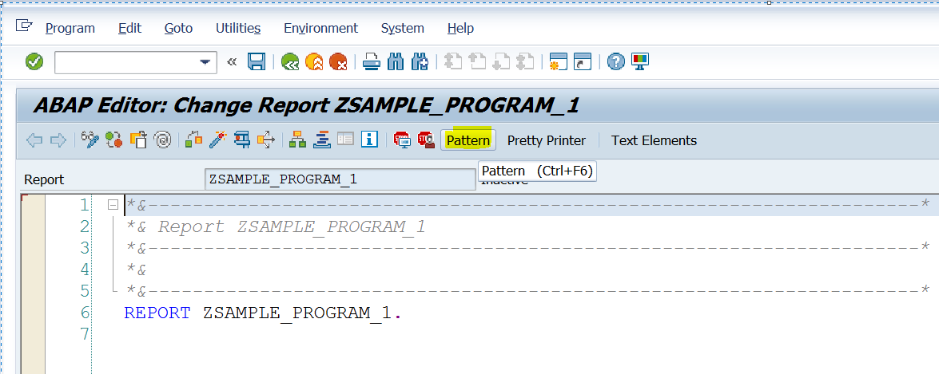
Calling of Function Modules
We can call the function module in a program through the pattern button.
Click on the pattern button and pass the function module name by choosing
call function radio button.
Pattern button in ABAP Editor

Slide 11
Subroutines
Subroutine is also a modularization technique.
A subroutine is a modularization unit with in the program itself.
There is no separate transaction code to create a subroutine.
A subroutine is a block of code introduced by FORM and ends with ENDFORM.

Slide 12
Types of Subroutines
Subroutines are of 2 types.
Internal Subroutines - Subroutines which are defined and used in a same program are called as internal subroutines.
External Subroutines - Subroutines which are created in one program and used in another program are called as external subroutines.

Slide 13
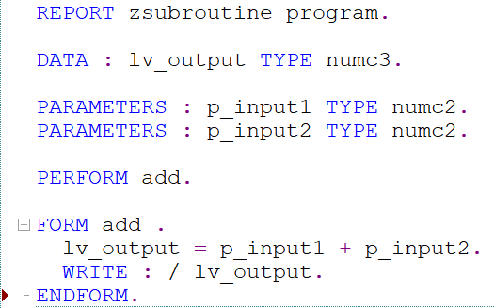
Syntax for Calling of Subroutine - Without Parameters
Syntax - PERFORM < perform name>.
In the example PERFORM = keyword ,
add = name of the subroutine,
the logic for the subroutine add is written
between FORM add and ENDFORM.

Slide 14
Syntax for Calling of Subroutine - With Parameters
Syntax - PERFORM <perform name> TABLES <tables parameters> USING <using parameters> CHANGING <changing parameters>.
We cannot change the sequence of tables using changing , but if any of them (tables/using/changing) is not required, we can skip it.

Slide 15
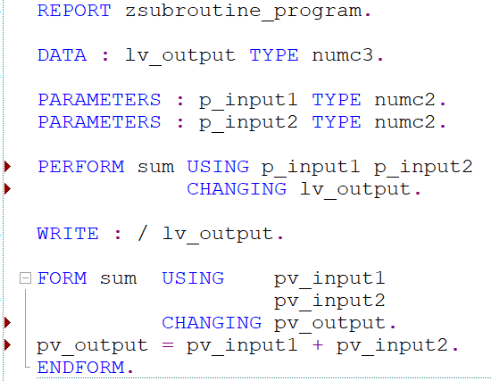
Syntax for Calling of Subroutine - With Parameters(Contd.)
In the example PERFORM, USING and
CHANGING = keywords,
sum = name of the subroutine,
p_input1 and p_input2 = using parameters,
lv_output = changing parameter.

Slide 16
Subroutine - Actual Parameters and Formal Parameters
Parameter names that appear on the PERFORM
statement are called actual parameters.
Parameter names that appear on the FORM
statement are called formal parameters.
p_input1 , p_input2 , lv_output = actual parameters,
pv_input1 , pv_input2 , pv_output = formal parameters.

Slide 17
Subroutine With Parameters - Important Points
Perform and form statement must contain the same number of parameters. It means the number of actual parameters must be same as that of formal parameters.
The addition tables , using and changing can only occur once in a statement.

Slide 18
Subroutine - Pass by Value and Pass by Reference
In pass by value , the value is copied from actual parameter to formal parameter, If we change the value of formal parameter the value of actual parameter will not change whereas in pass by reference, we pass the address of actual parameter to formal parameter, any changes done to the formal parameter value will change the value of actual parameter also.
In pass by value, the formal parameters have the memory of their own whereas in pass by reference, the formal parameters does not have the memory of their own.

Slide 19
Comparison of Include Programs With Function Module & Subroutine
Include programs does not have an interface( there is no provision to pass input and output parameters) whereas function module and subroutines has interface(there is a provision to pass input and output parameters).

Slide 20
Function Modules and Subroutines Comparison
There is a separate transaction code SE37 (workbench tool) to create a function module whereas there is no separate workbench tool to create a subroutine.
We can check the output of function module using F8(we can independently run a function module to check the output) whereas we cannot run a subroutine independently.
We can raise an exception in function module using exception tab whereas in subroutines there is no exception tab.

Slide 21
Macros - Introduction
It is also a modularization technique.
Whenever we want to reuse a set of statements ,we can include them in macro.
Then we can use that macro in our source code instead of writing the statements again and again.
We define a macro with in DEFINE and END-OF-DEFINITION statement.

Slide 22
Macros - Creation Steps
Macros creation is 2 step process.
Macro Definition
Macro Calling

Slide 23
Macro Definition
We need to firstly define the macro.
The definition of the macro include the reuseable set of statements.
Syntax to define a Macro : DEFINE <macro name>. <statements> . END-OF-DEFINITION.

Slide 24
Macro Calling
In the second step, we need to call the defined macro at various places inside the code.
Syntax to call a macro : <macro name>.
Imp point : Before calling, macro must be defined first.

Slide 25
Macros With Placeholders
Whenever we want to pass values to a macro, we create macro with placeholders.
These placeholders are replaced by values.
We can pass maximum up to 9 placeholders.
Syntax to define a macro with placeholders : DEFINE <macro name>. <statements> <&1, &2------&9>. END-OF-DEFINITION
Syntax to call a macro with placeholders : <macro name> <param1> <param 2> . In this syntax, param1 and param2 are the placeholder values.

Slide 26
Macros - Limitations
The various limitations of macros are as follows:
No reusability : Macros can only be used in the same program where it is defined. They can not be reused.
No debugging : We can not debug a macro code.
Increases program size : Macros are expanded at compile time. It is just like copy paste the code everywhere as many times we call it. When we have so many calls, it drastically increases the size of the program in the memory.

Slide 27
Macros Vs. Function Modules
The Macros are not reusable whereas function modules are reusable.
We can not debug a macro code whereas we can debug a function module code.
We can pass maximum 9 parameters in macro whereas we can pass any number of parameters using function modules.
During compilation the macro call is replaced with the code whereas when we call a function module the control passes to that section of code at runtime.

Slide 28
Macros Vs. Subroutines
The Macros are not reusable whereas subroutines are reusable.
We can not debug a macro code whereas we can debug a subroutine code.
We can pass maximum 9 parameters in macro whereas we can pass any number of parameters using subroutines.
Macros are expanded at compile time whereas subroutines are expanded at runtime.

Slide 29
Thank You

